Slide 1

Bluetooth Android Intern Project -Semester Extension- Gate 1
Blaine Tiernan

Slide 2
Meeting Agenda
Gate 1 – Bluetooth Android Intern Project
Market Overview
Business Estimates
Risk
Gate 1 Deliverables
WBS
MRS

Slide 3
Market Overview
Bluetooth Android Intern Project
Market drivers for Android Application w/ Bluetooth
Estimated 36.7 % of US smartphones are Androids.http://www.statisticbrain.com/android-phone-statistics/
59% of US tablet owners have Android Tablets. http://www.emarketer.com/Article/With-More-Models-on-Market-How-Tablets-Stacking-Up/1009982
Android App would keep Technicians from having to carry around a laptop.
Helps sell Flow Computers.

Slide 4
Market Overview
Bluetooth Android Intern Project
Competition
Seeing as that this project was designed as a bonus for the consumer to make communicating and pulling readings from G4 flow computers easier, there is no real competition.

Slide 5

Market Overview
Bluetooth Android Intern Project Technology
How it works
User will connect to G4 device through Bluetooth or Wifi to the Android Totalflow Application to gather trending data from G4 device.
Bluetooth Advantages over PCCU
Serial Linkup
Allows Wireless communication
Allows phone only communication,
Laptop no longer necessary
Can be operated from within the comfort of vehicle

Slide 6
Financial Analysis
Business Case Summary
 | Most Likely | Optimistic | Pessimistic
Time (in Weeks) | 16 | 14 | 18
Cost of Labor (in US Dollars) | 15,859.20 | 13,876.80 | 17,841.60

Slide 7
Financial Analysis
Risk Summary
Risk Description | Schedule Impact | Scope Impact | Budget Impact | Total Impact | Likelihood Mutliplier | Quantitative Risk Value (1-15) | Status | Mitigation
Device Remember' Function Non-Functional | 3 | 3 | 3 | 9 | 70.00% | 6.3 | Closed | Closed 9/26/13 – Function Fixed
Inexperience w/ Objective C and its Translation from Java | 3 | 3 | 3 | 9 | 100.00% | 9 | Closed | Closed 9/26/13 – Accepted as Stretch scope and will be undertaken only if time permits
G4 Device Unexpectedly Switching from Local to Remote | 4 | 5 | 4 | 13 | 80.00% | 10.4 | In Progress | Scheduled Research – attempt to never disconnect
Write Register Incompatibility with Past Design | 3 | 4 | 3 | 10 | 100.00% | 10 | Open | Suggestion: Ground up Software Rewrite
Bluetooth Successful Connection Inconsistency | 3 | 4 | 3 | 10 | 100.00% | 10 | Open | Suggestion: Ground up Software Rewrite
Register Display Facelift Requires Surplus Manhours | 2 | 3 | 2 | 7 | 80.00% | 5.6 | Open | Suggestion: Ground up Software Rewrite
Android Firmware Incompatibility | 1 | 1 | 1 | 3 | 30.00% | 0.9 | Open | Testing Application for the Most Popular Firmware Releases: 2.3.3 and 4.3

Slide 8

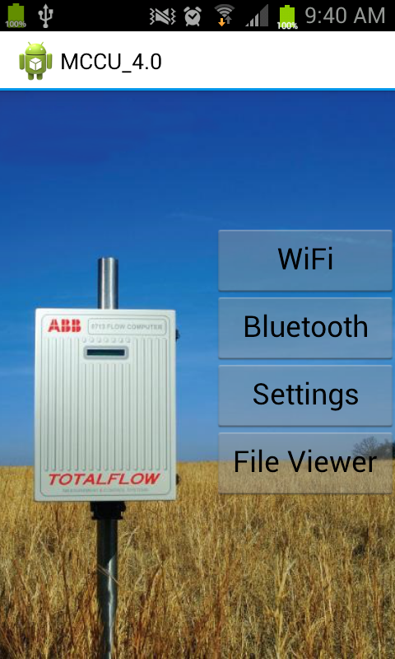
Main Menu – Page 1

Slide 9
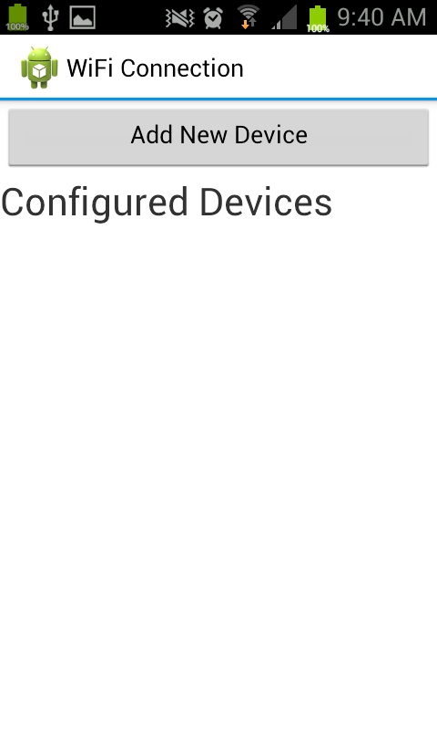
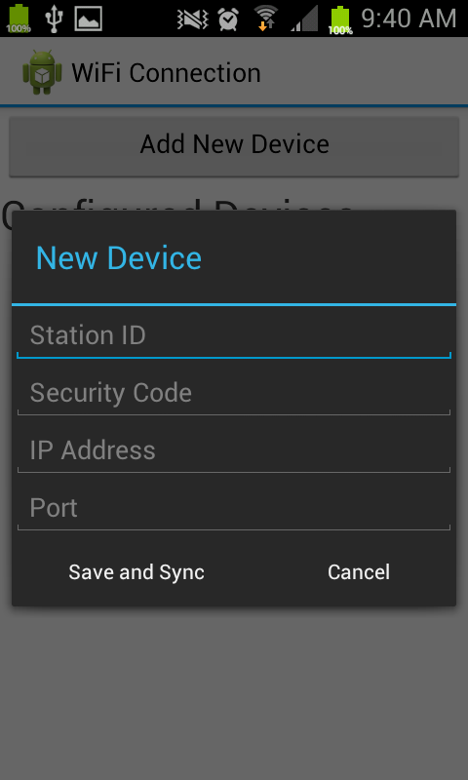
Wi-Fi Connection – Page 1A

Slide 10
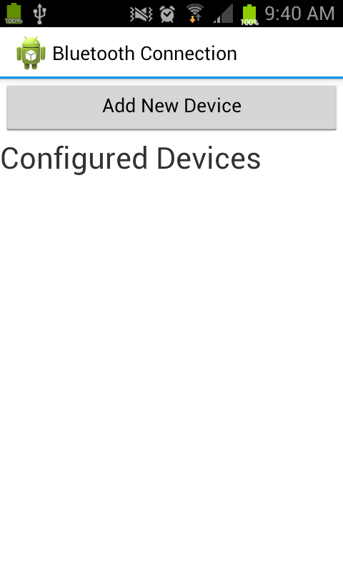
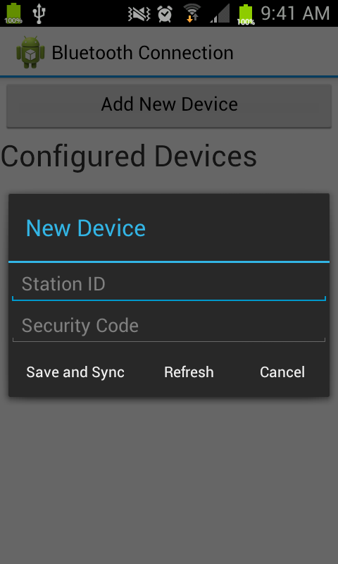
Bluetooth Connection – Page 1B

Slide 11
Bluetooth Android Intern Project Gate 1
Gate 1 Deliverables / Milestones
Work Breakdown Structure (WBS)
Effort Estimate
Project Charter (MRS)

Slide 12
Bluetooth Android Intern Project Gate 2
Gate 2 Deliverables/Milestones :
Technical Requirements Document
Detailed product requirements based on Marketing Requirements Specification
High level software architectural solution
Traceability back to Marketing Requirements Specification
Product Development Plan
Development strategy
Resource requirements
Detailed schedule
Development costs
Project risks & mitigation plan
Gate model deviation requests/approval

Slide 13
Bluetooth Android Intern Project Gate 3
Gate 3 Deliverable/Milestone:
Software/Physical Design Specification
Software Component Definition
Detailed Design Document
Traceability to Technical Requirements Document

Slide 14
Bluetooth Android Intern Project Gate 4
Gate 4 Deliverable/Milestone:
Software
Code and unit testing
Integration testing (white box)
Software design verification testing (white & black box testing)
System/Quality Testing
System Test Plan/Procedures (Black box testing – requirements)
System Automation Test development
Alpha Unit Build
Alpha testing is scheduled to start after the 9th of July. Testing will be coordinated by the project manager and the testing customers will be interns Kevin Bright, Nathan Lea, and Trevor Hermosillo.

Slide 15
Bluetooth Android Intern Project Gate 5
Gate 5 Deliverable/Milestone:
Software Release

Slide 16
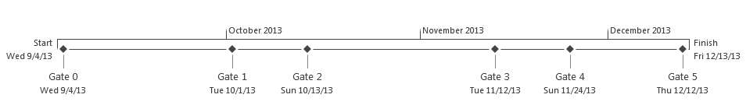
Bluetooth Android Intern Project Timeline

Slide 17
Bluetooth Android Intern Project Gate 1
Gate 1 Deliverables / Milestones
Work Breakdown Structure (WBS)
Effort Estimate
Project Charter (MRS)

